Slide 1
Set Up GitHub Desktop
FrameworkTV.com

Slide 2
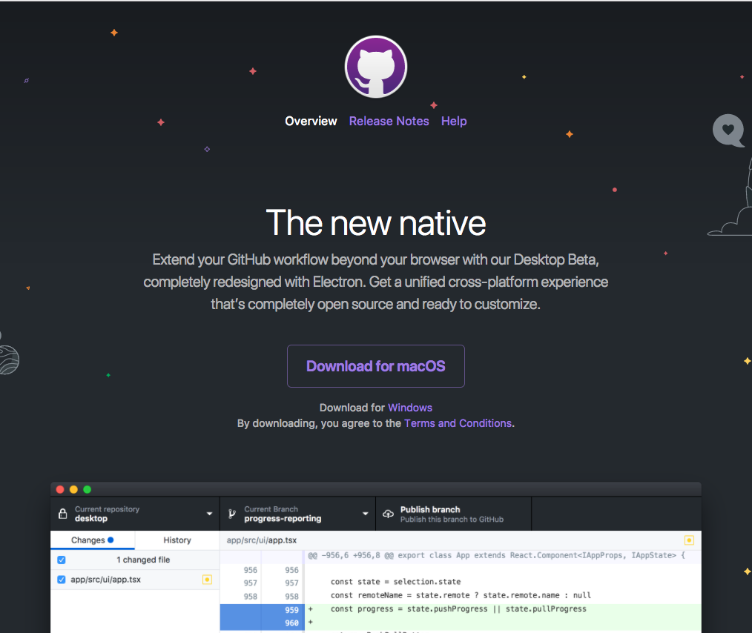
Installation
Go to https://desktop.github.com/
Click on the button in the middle of the screen to install the version for your OS
Follow the steps to complete the installation

Slide 3
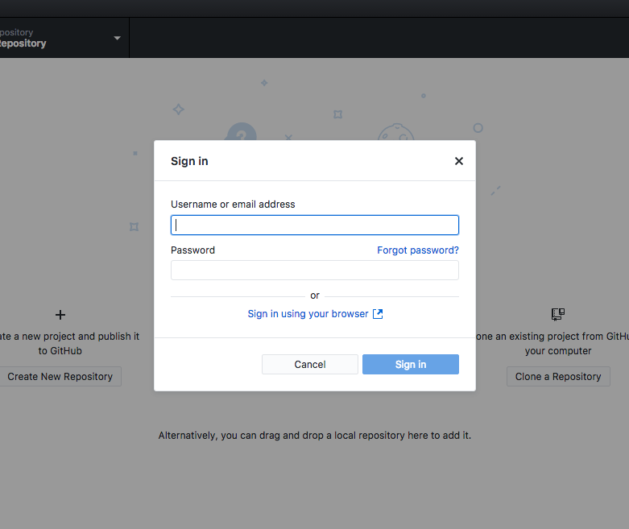
Connect Account
Start the newly installed GitHub Desktop application
A screen will appear that will ask you to log in with your GitHub username and password
If you’re already logged in to your browser, you can use the ‘Sign in using your browser’ link to connect your account to the application.

Slide 4
Creating Your Local Project
In order to keep your code clean and consistent, we will be following a specific format for your code repository.
Use the screenshot in the next slide to begin creating the folder structure for your courses.
If you’ve already spent some time on the course, go back and reconfigure the folder structure as follows.

Slide 5
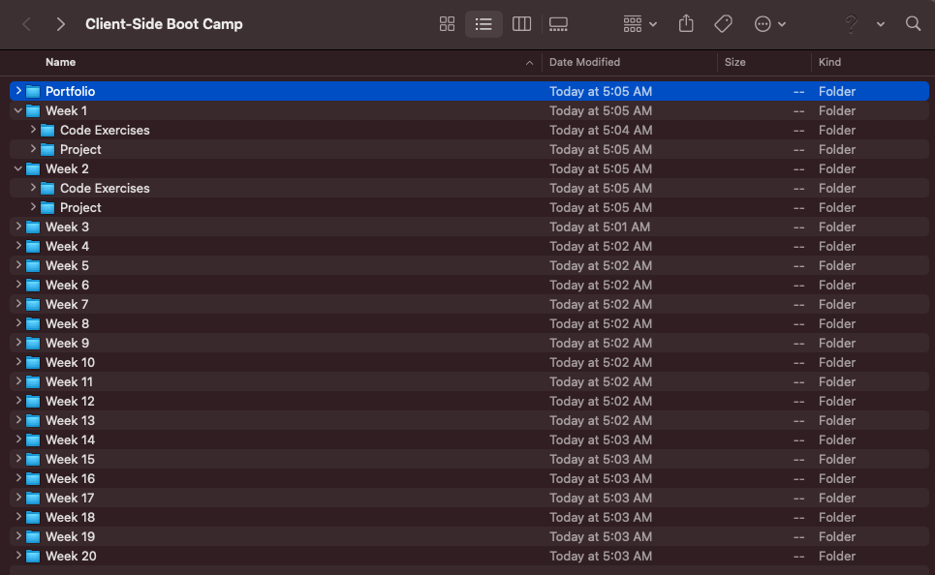
Creating Your Local Project

Slide 6

Creating Your First Repository
After you’ve created your folder structure, click on the ‘Create New Repository’ button.
Give the repository the same name as the folder you created on Slide 4.
Make sure the box for ‘Initialize this repository with a README’ is checked.
Note: Make sure you choose the folder that contains the folder you created, not the actual folder.

Slide 7
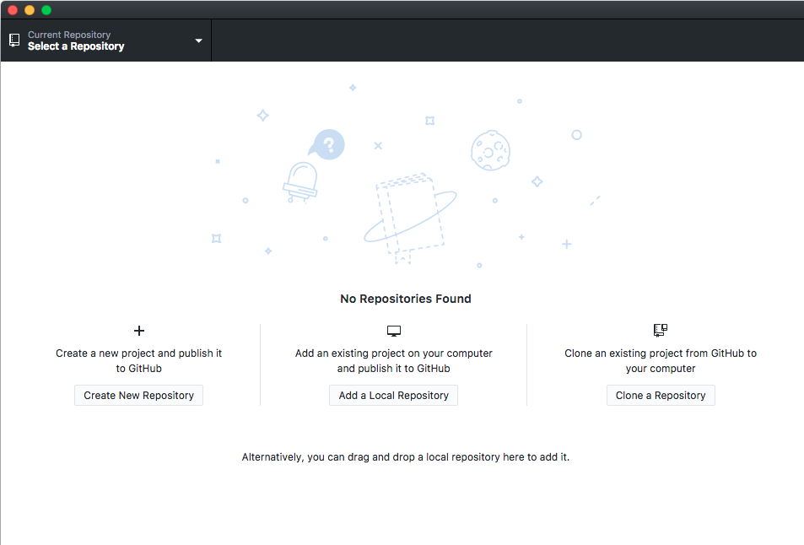
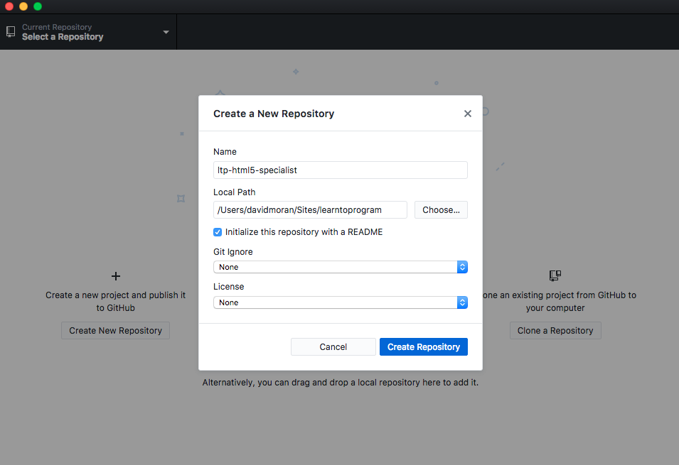
Creating Your First Repository

Slide 8
Prepare Folder for GitHub.com
Open the folder you created in Brackets.
In the README.md file, edit the line below to reflect your name and the current course you’re working on. Make sure that you include the hash
Example: # David’s Client-Side Boot Camp Repository
Save the file and open your GitHub Desktop Client to see your changes
Note: Empty folders do not get sent through GitHub, so do not worry if the folders you created are not shown in GitHub Desktop

Slide 9
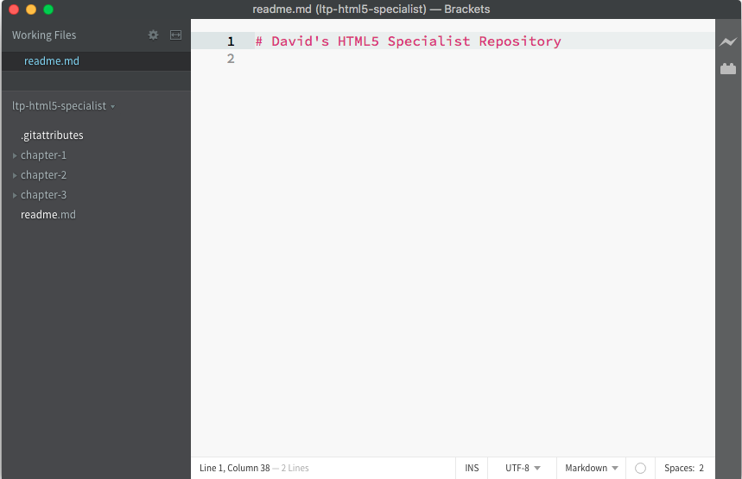
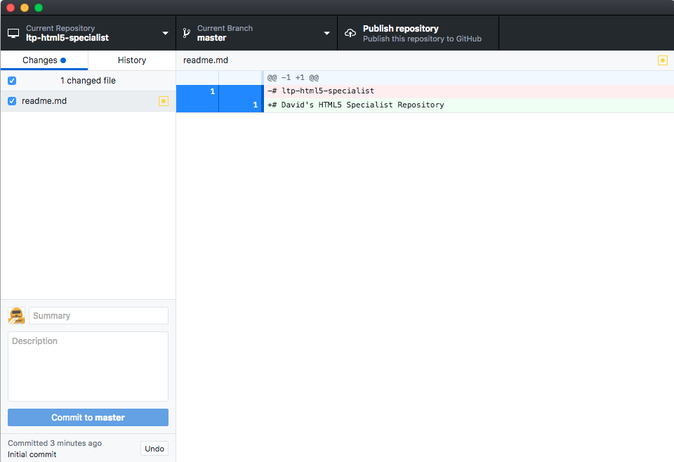
Prepare Folder for GitHub.com

Slide 10
Sync to GitHub
On the left hand side in the ‘Summary’ field, add the title ‘Update Title of README’ and click on the ‘Commit’ button.
Click on the ‘Publish Repository’ button at the top right.
Uncheck the ‘Keep this code private’ checkbox, hit the second ‘Publish Repository’ button.
Wait until the popup box disappears to let you know the syncing is complete.

Slide 11
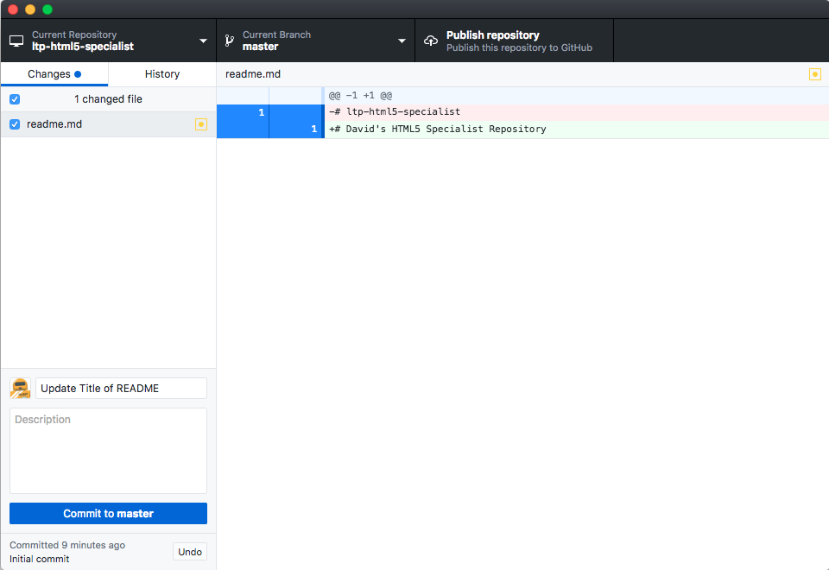
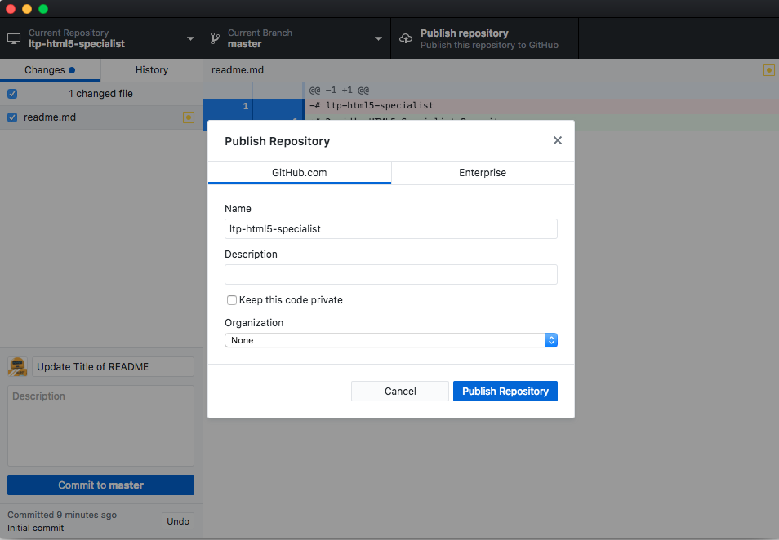
Sync to GitHub

Slide 12
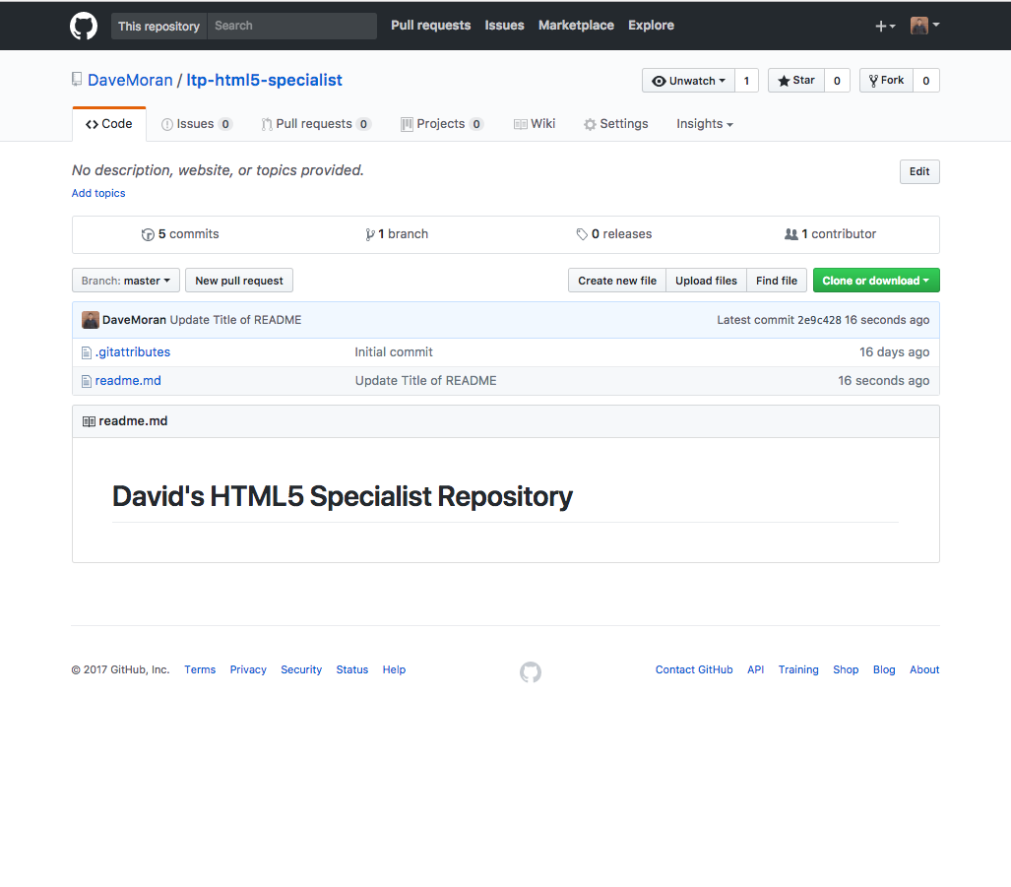
Confirmation
After syncing has been completed, go to GitHub.com and login. You should see the new repository on your right hand side of the screen
Click on the name of the new repository and confirm that your changes have been synced to GitHub.com
Your screen should look similar to the screen to the right

Slide 13
Going Forward
Have any questions or run into any errors? Reach out at the Framework Family with questions or problems! We’re here to help.
family.frameworktv.com

